Slide 1
Generative Adversarial Networks
Sukho Lee(이석호)
Dongseo Univ.
@울산대학교 2017.7.17~18

Slide 2
Generative Adversarial Networks ( GAN )
The coolest idea in ML in the last twenty years - Yann Lecun
Generative : Trying to generate things (that looks real)

Slide 3
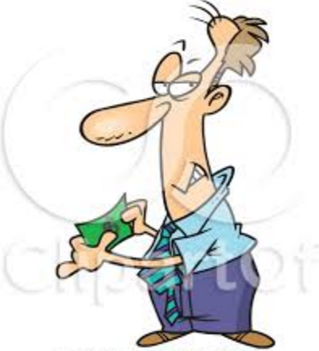
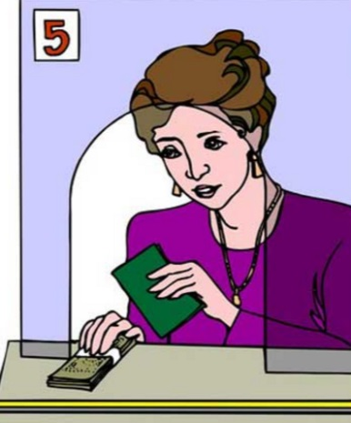
Two Operators (Networks) competing against each other
George
(Generator)
Make fake money
to deceive Danielle
Danielle
(Discriminator)
Discriminate between
fake and real money

Slide 4
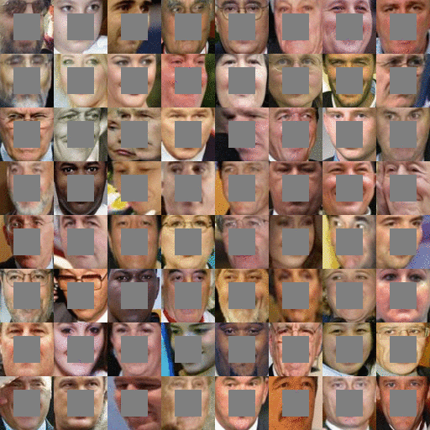
Example: Generating part of faces

Slide 5
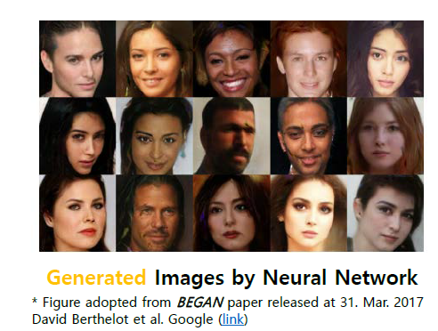
Example: Generating faces

Slide 6
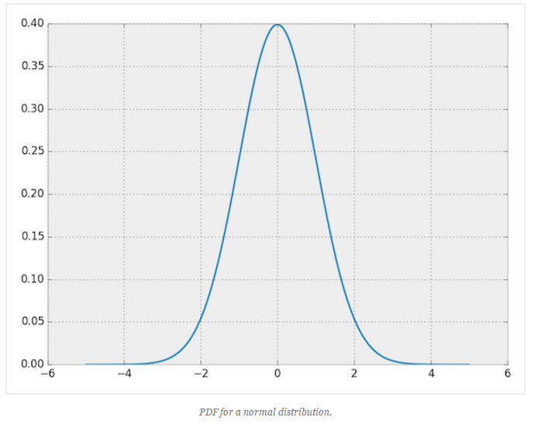
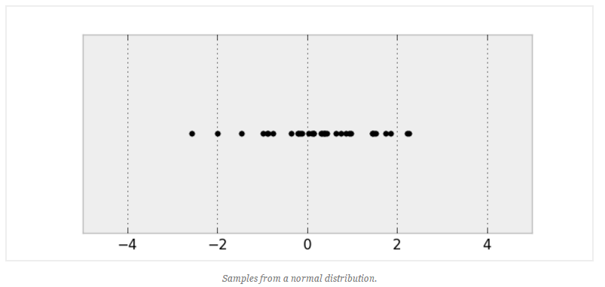
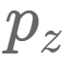
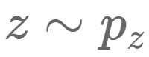
Probability Density Function
PDF : Probability Density Function
Sample drawn from the PDF

Slide 7
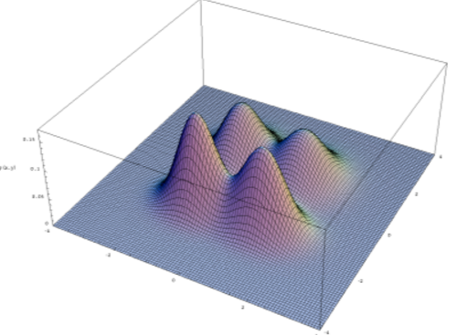
Probability Density Function: (2D)
probability of 0.9 to generate the vector
(3,2)
0.9
0.01
2
3
4
1
probability of 0.01 to generate the vector
(4,1)
The above PDF will generate vectors like (3,2) rather than (4,1)
Think of (3,2) as a face, and (4,1) as a noise. Then the above model will generate faces rather than noises.

Slide 8
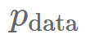
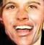
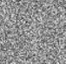
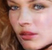
Problem of finding PDF
If we know the true PDF then we can generate faces by just drawing samples from
This PDF
Problem? Cannot know this PDF.
(A PDF in very high dimensional space)

Slide 9
Choice of Model
1
1
1
1
Model1:
0
0
5
6
1
1
1
1
Model2:
0
0
5
6

Slide 10
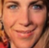
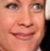
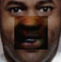
Instead
1
1
1
1
0
0
Try to find a mapping which can discriminate between true(1) and false(0) faces
Try to find this mapping given several data sets
→ Find a network that do this mapping : CNN can do the job

Slide 11
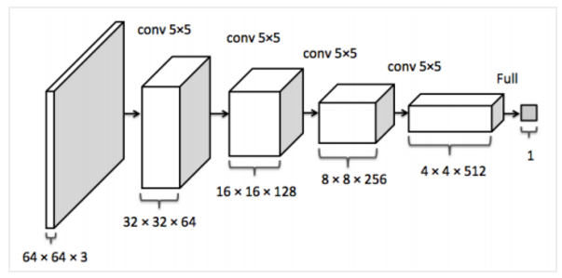
Discriminator( ) in DCGAN
Parameters : Weights

Slide 12
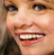
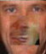
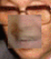

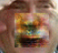
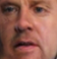
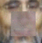
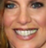
1
1
1
1
1
1
1
1
0
0
0
0
0
0
true
false

Slide 13
1
1
1
1
1
1
1
1
0
0
0
0
0
0
true
false
Generator

Slide 14
Update based on
1
1
1
1
1
1
1
1
0
0
0
0
0
0
Try “not” to generate these vectors
Try to generate these vectors
Generator
Update
Generator+

Slide 15
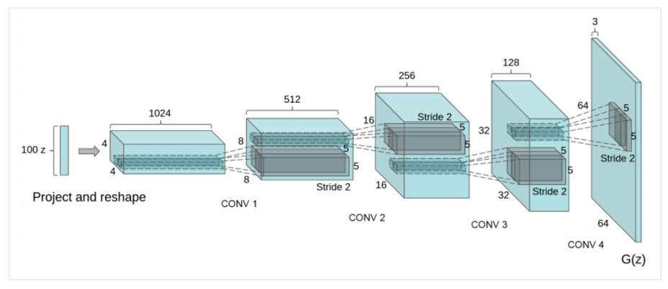
Generator( ) in DCGAN
Parameters are the weights
: Defined by

Slide 16


Convolution vs. Strided Convolution
Convolution
Fractionally-strided convolution
Zero

Slide 17
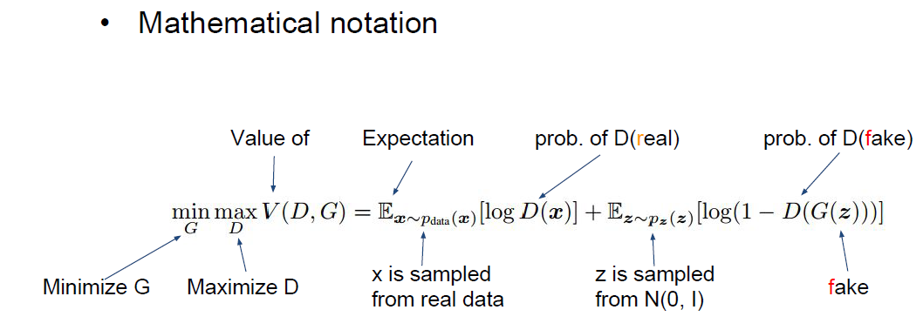
Mathematical Notation

Slide 18
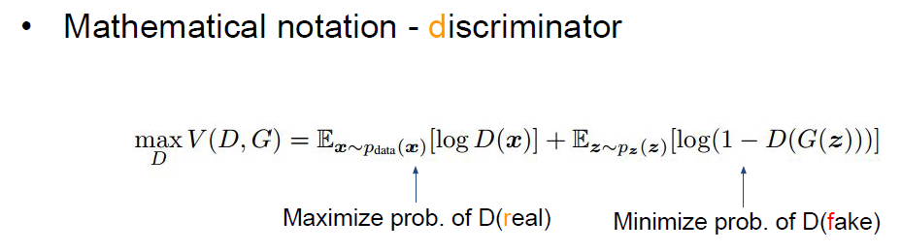
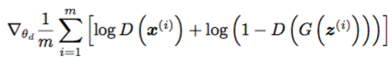

Slide 19
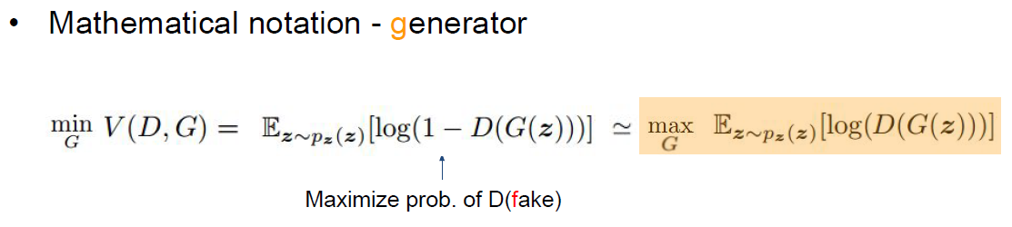
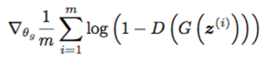

Slide 20
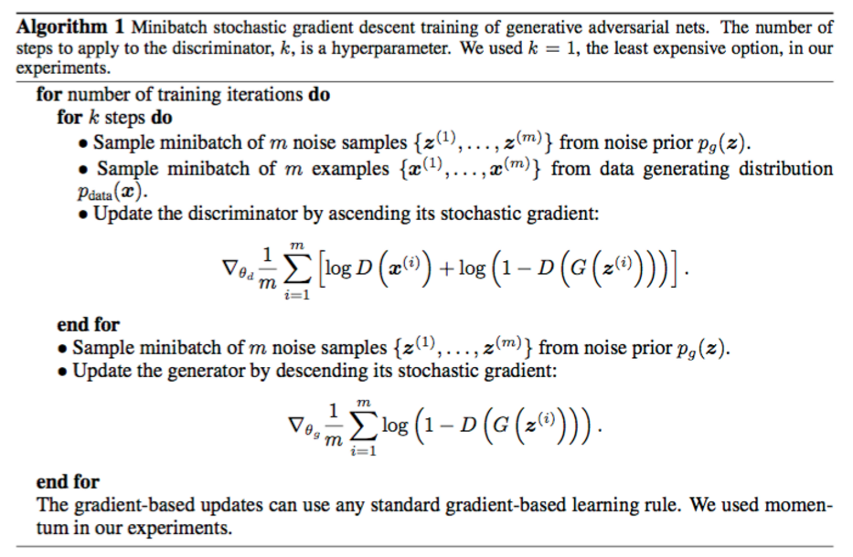

Slide 21
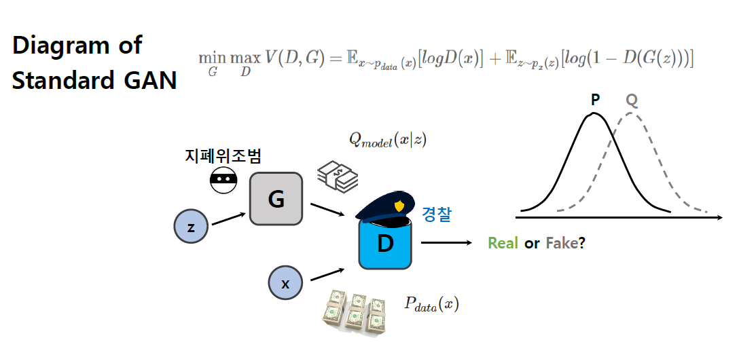
(유재준의 강의자료에서 인용)

Slide 22
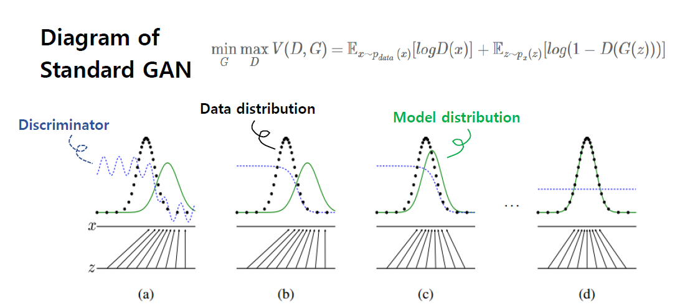
(유재준의 강의자료에서 인용)

Slide 23
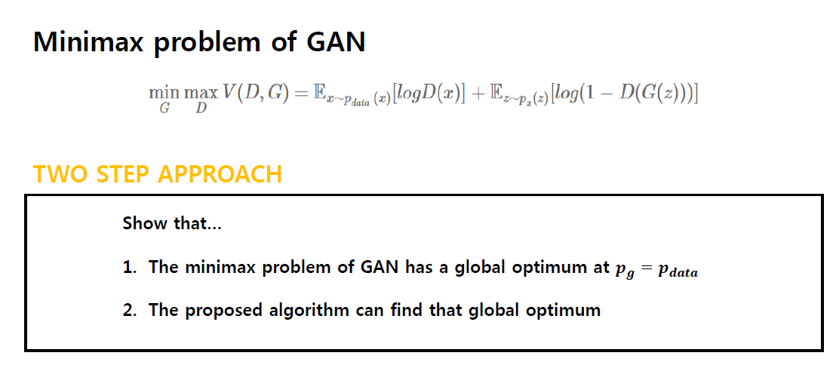
(유재준의 강의자료에서 인용)

Slide 24
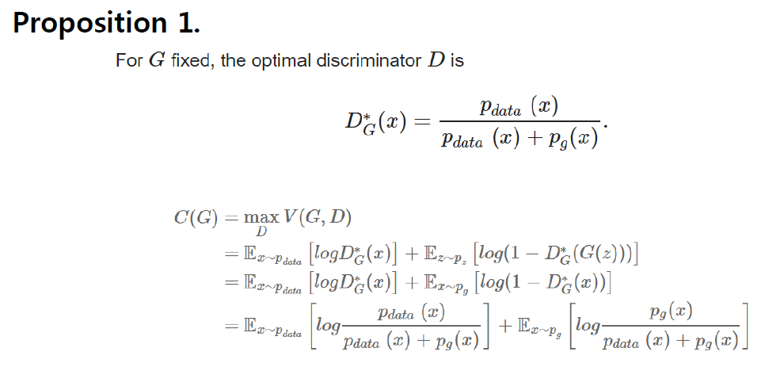
(유재준의 강의자료에서 인용)

Slide 25
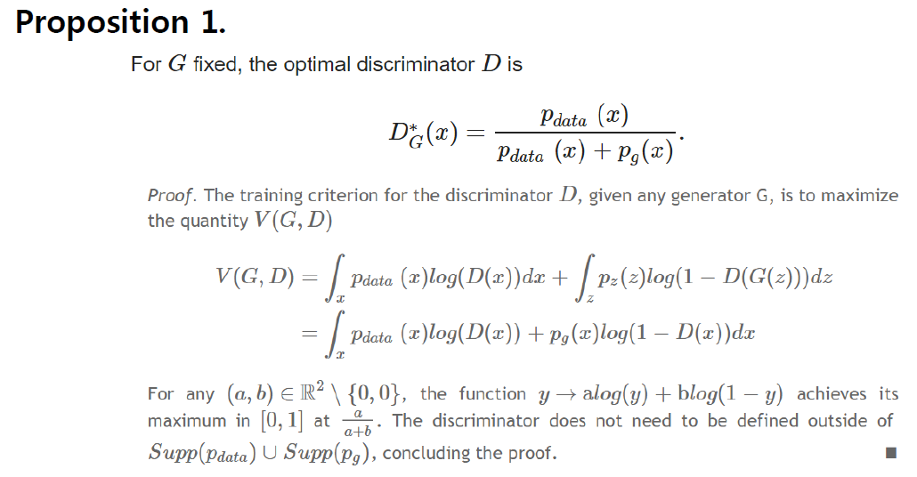
(유재준의 강의자료에서 인용)

Slide 26
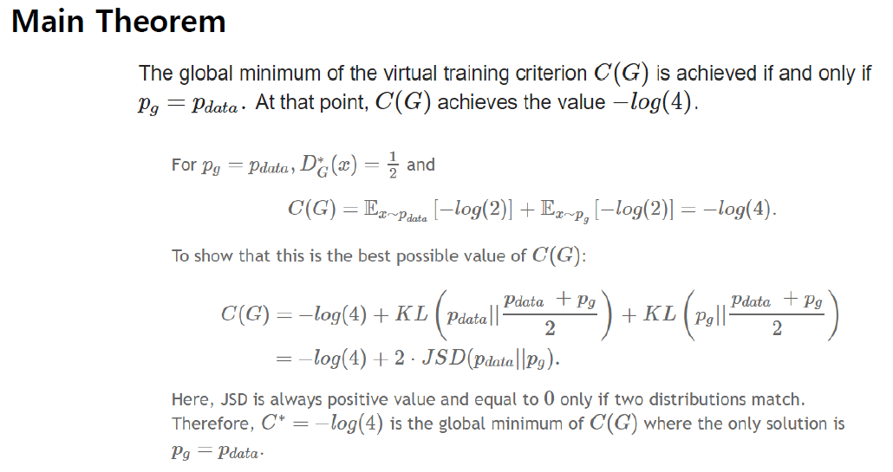
(유재준의 강의자료에서 인용)

Slide 27
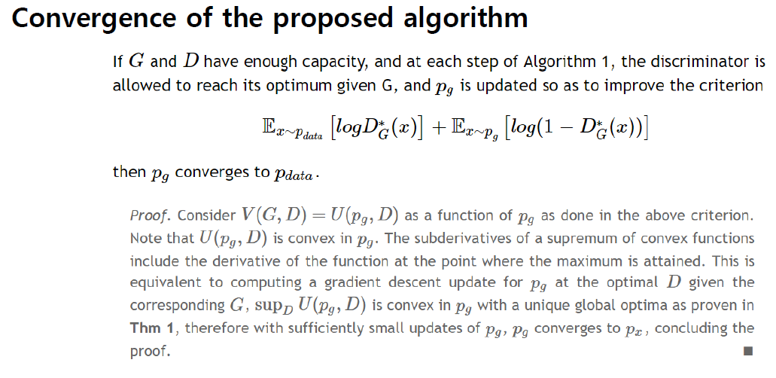
(유재준의 강의자료에서 인용)

Slide 28
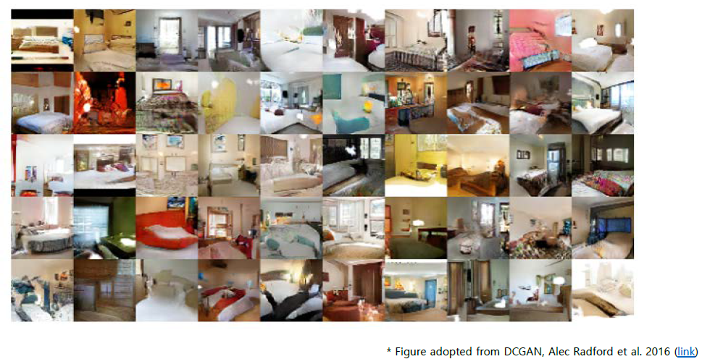
What can GAN do?

Slide 29
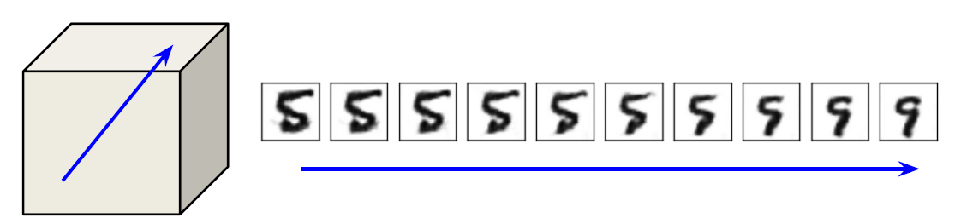
What can GAN do? (walking in the latent space)

Slide 30
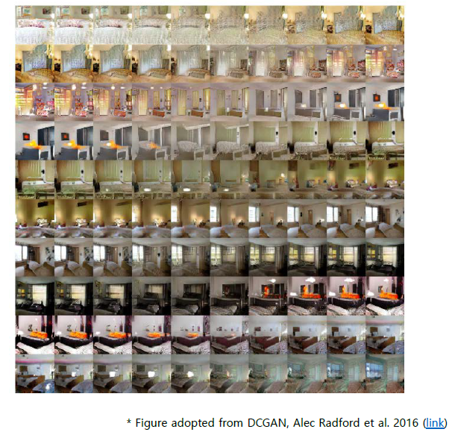
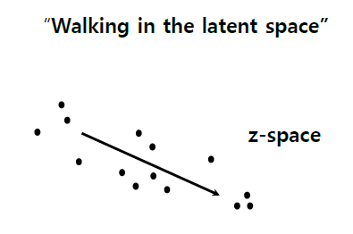
What can GAN do? (walking in the latent space)

Slide 31
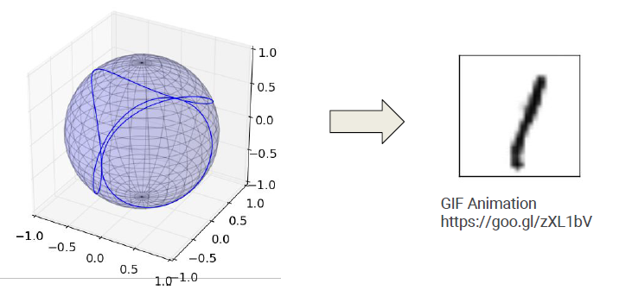
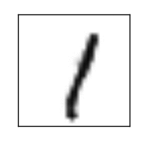
What can GAN do? (walking in the latent space)

Slide 32
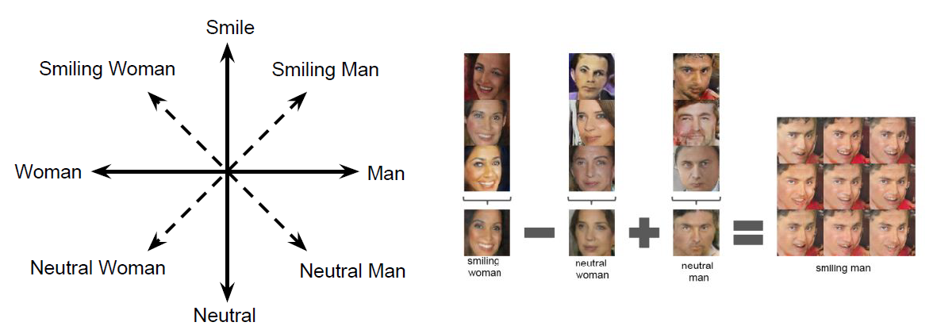
What can GAN do? Linear vector arithmetic

